Slide 1

Location Privacy – K anonymity & Obfuscation
Food Delivery system
Sai Karthik dattu
Sai Krishna
Sai Sandeep
University of Maryland Baltimore County

Slide 2
Table of contents
1. Motivation
2. Methodology
3. Demo
4. Results
5. Future Enhancements

Slide 3
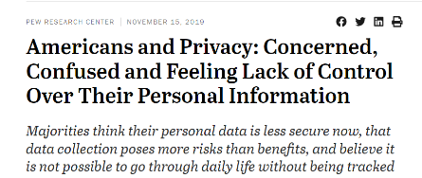
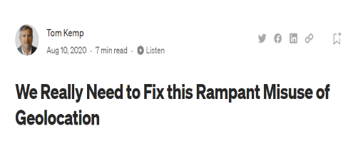
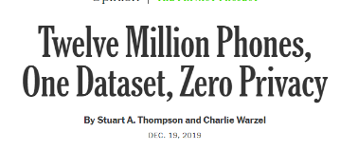
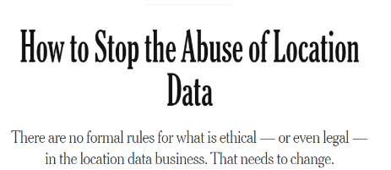
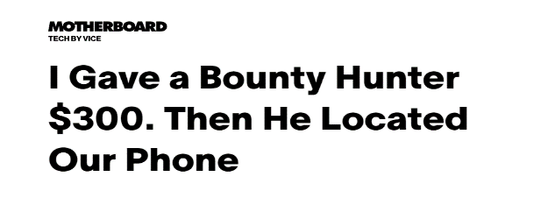

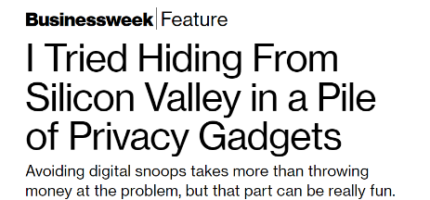
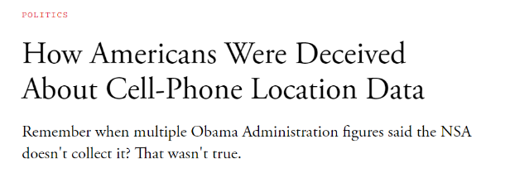
Motivation

Slide 4
Methodology
K- anonymity
a) Data dependent Cloaking
Distance-based cloaking
K- bucket cloaking
b) Space Based Cloaking
Grid cloaking
Region cloaking

Slide 5
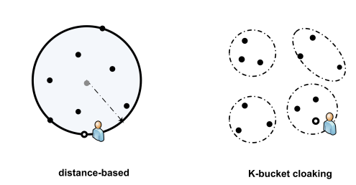
Methodology
Data dependent Cloaking

Slide 6
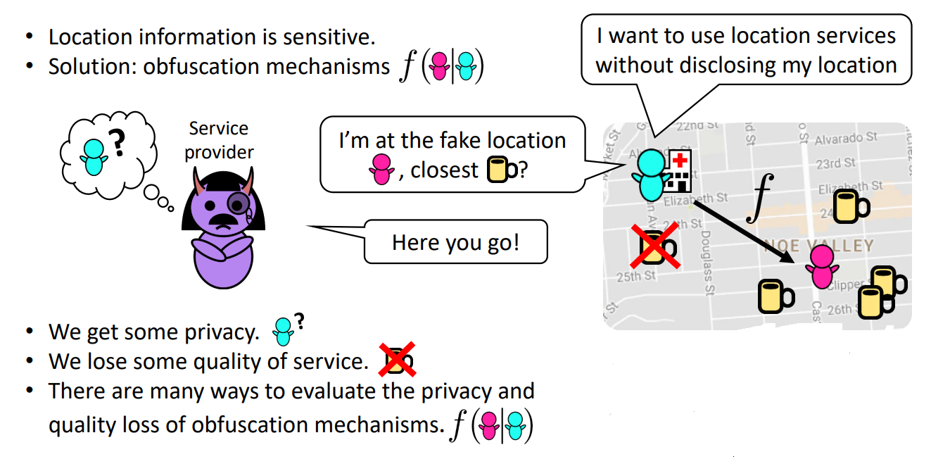
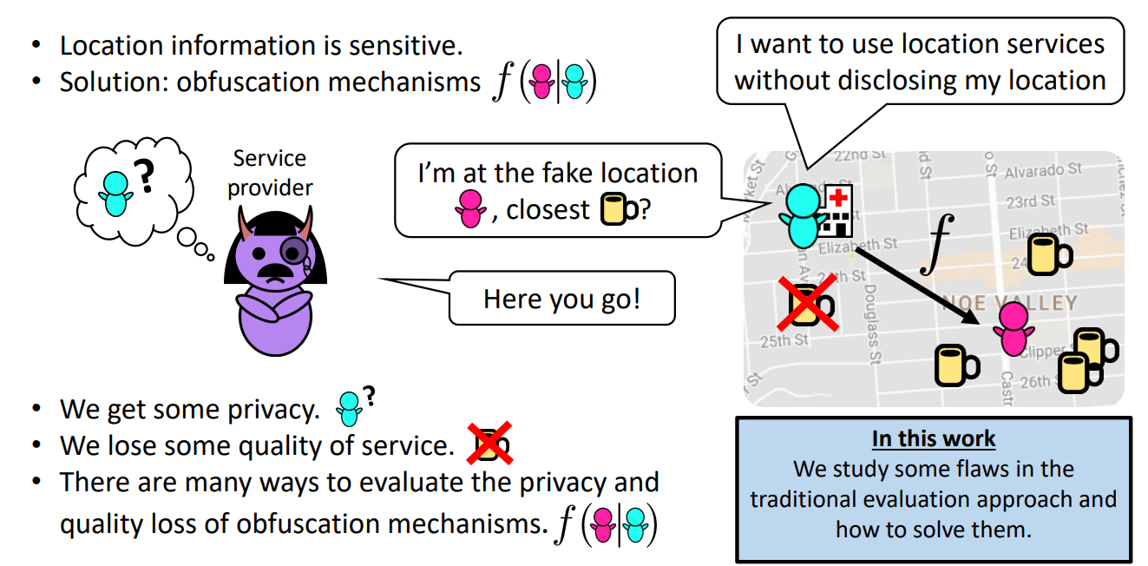
Methodology

Slide 7
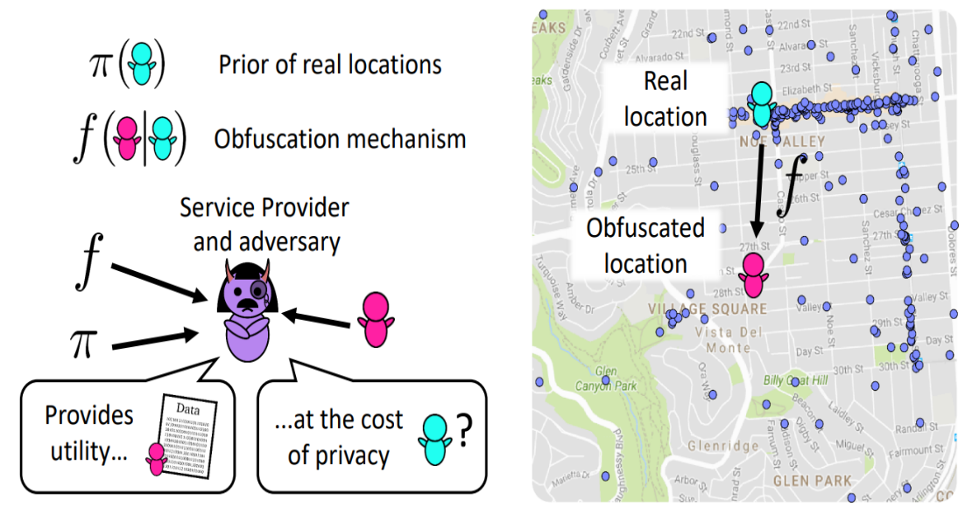
Methodology

Slide 8
DEMO

Slide 9
Results
1. Density of houses
If more: Provides more anonymity and utility too.
If less: Limited anonymity and utility.
2. It all depends upon the user.

Slide 10
Technologies Used
ReactJS
Maps SDK by Google
Google Cloud Platform (GCP)
NodeJS
Material UI
Bootstrap

Slide 11
Future Enhancements
A certain value of k would improve the amount of privacy. It will, however, certainly entail some additional costs. As a result, in our future work, we will conduct study on the determination of k.

Slide 12
References
https://www.kdd.org/exploration_files/v12-1-p3-gkoulalas-sigkdd.pdf
https://www.youtube.com/watch?v=-j-H7U0I6Ao&t=973s
https://simon-oya.github.io/files/oya-2017-11-ccs-slides.pdf
https://spdp.di.unimi.it/papers/pcac07.pdf

Slide 13
Thank You

